Slide 1
Lending Club Case Study
Team Members
Balvant Chauhan
Akhil Pentamsetti

Slide 2
Problem Statement
The Lending Club is a company which is the largest online loan marketplace, facilitating personal loans, business loans, and financing of medical procedures.
The company wants to understand the driving factors (or driver variables) behind loan default.
If one is able to identify these risky loan applicants, then such loans can be reduced thereby cutting the losses. Identification of such applicants using EDA is the aim of this case study.

Slide 3
Process Approach
Clean Data
Drop null value columns, random values, and single category values
Convert values into proper program readable values
Univariate Analysis
Understand distributions of various numerical and categorical columns
Segmented Univariate Analysis
Segment the categorical variables and analyse
Create derived variables
Bivariate Analysis
Understand the correlation between variables, and see how they affect each other
Summarize Results

Slide 4
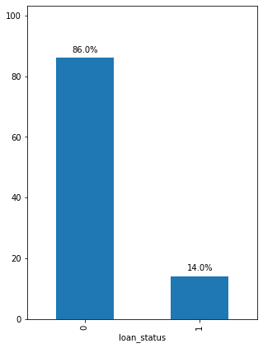
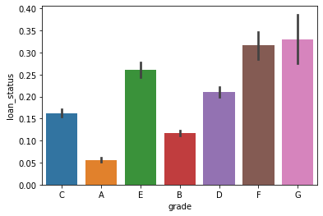
Overall Loan Status Analysis
About 14% of the loans are being defaulted
It clearly shows that as the grade of loan goes from A to G, the default rate increases. This is expected because the grade is grouped by Lending Club based on the riskiness of the loan.

Slide 5
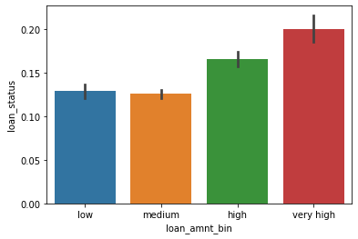
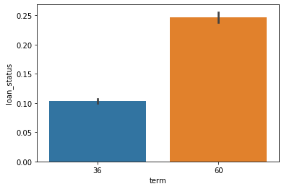
Analysis Based on Loan Amount & Term
If the loan amount increase chances of default rate also increase.
The above plot clearly shows that 60 months loans default is more than 36 months loans i.e. the more the term increases chances of default is also increase. [Univariate analysis]

Slide 6
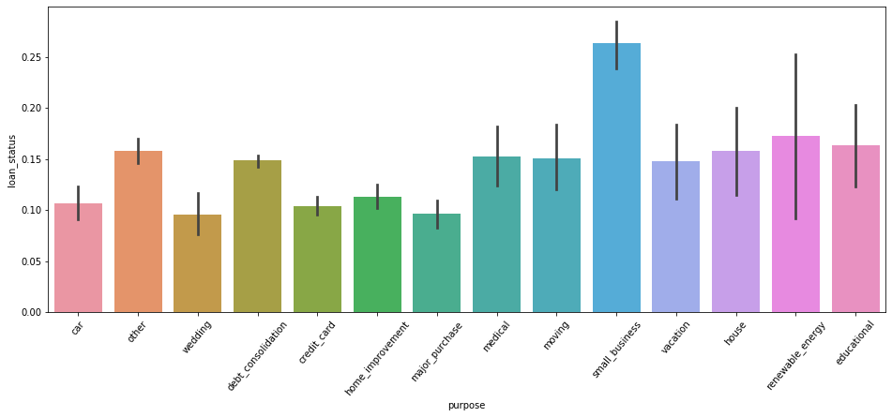
Analysis Based on Type of Loan
The variable purpose shows that small business loans default the most, then renewable energy and education.

Slide 7
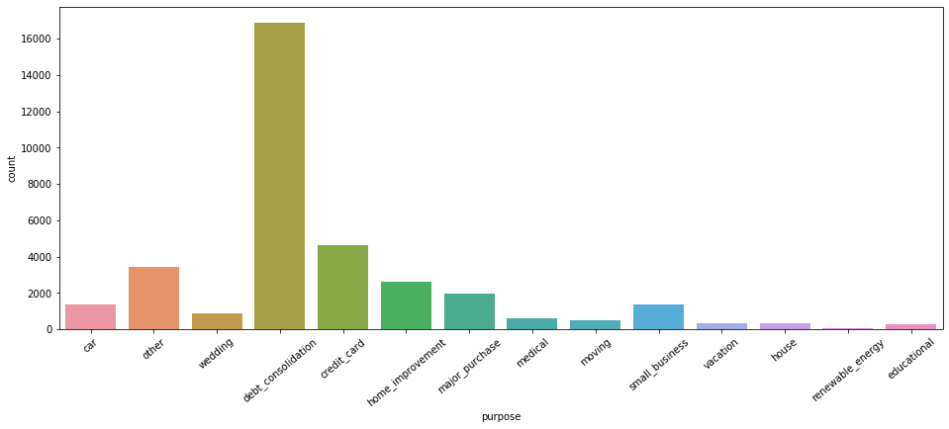
Based on Purpose of The Loan
Below plot shows the most loans are taken for debt consolidation (to repay other debts), then credit card, major purchase etc.

Slide 8
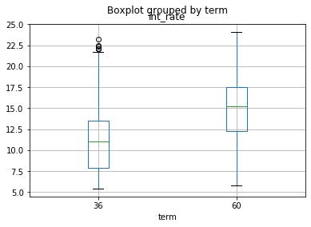
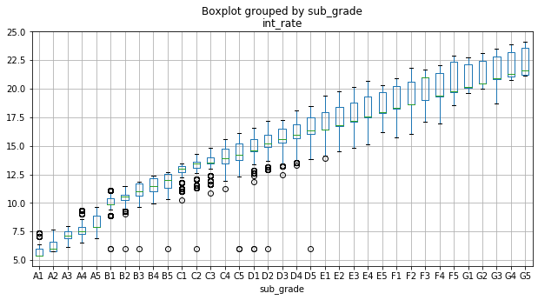
Analysis Based on Interest Rates
From the below plot we can understand that larger the term higher the interest rates.
Interest rates varies directly with the subgrade. Larger or worst the sub grade, higher are the rate of interest for the loan.

Slide 9
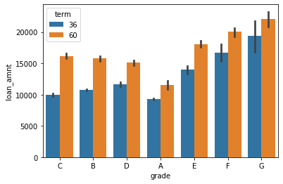
Grade vs Term in Bivariate Analysis
Our assumption made during univariate analysis is more evident with this plot. Higher loan amount are associated with lower grade for longer terms.

Slide 10
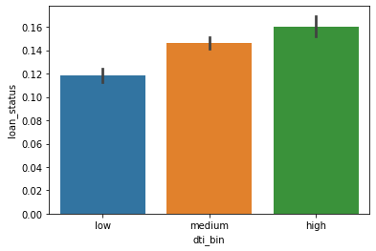
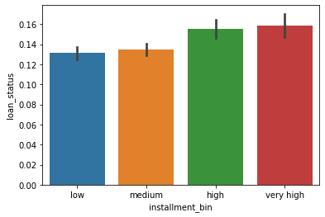
DTI and Installment Bin
High dti translates into higher default rates, as expected
The below plot shows that higher the installment amount, the higher the default rate

Slide 11
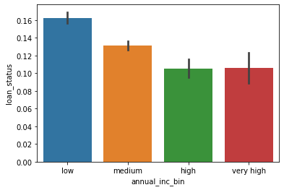
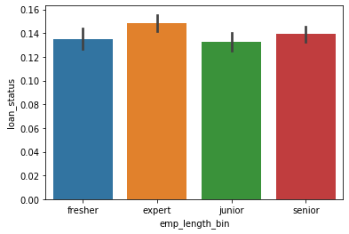
Analysis Based on Income & Emp length
From above plot we can infer that lower the annual income, higher the default rate
We can not predict default rate from employment length plot as it is almost flat for this variable.

Slide 12
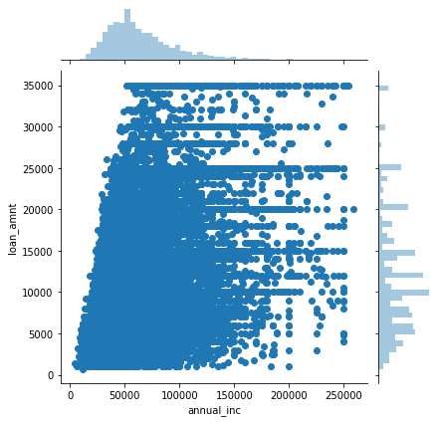
Annual Income and Loan Amount
It shows that there are people with average income lower than 50000 taking loans of 25000 or higher.
This indicates that the Lending Club is giving more loans for those who is having low annual income.
This should be stopped as it is a bad practice.

Slide 13
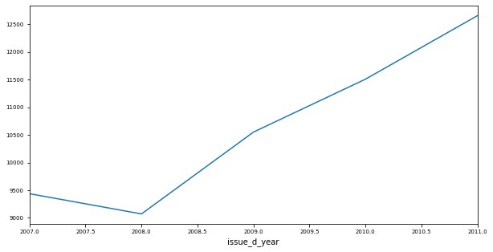
Avg Loan Amount over Time
Average loan amount dropped sharply when subprime mortgage crisis hit. Later one can see the increase in the loan amount.

Slide 14
Default Rates by Behavioural Variables
Behaviour | Change of default % from low to high
term | 15.0
purpose | 5.0
int_rate_bin | 19.0
installment_bin | 3.0
dti_bin | 5.0

Slide 15
Suggestions or Recommendations
Don’ts
Approving loans where loan amount / principal amount is greater than 30 % annual income
Approving very long term loans, which may lead to default
Giving loans or higher loan amounts to prior bad record people.
Do’s
Charge higher interest rates for loans with greater dti
Reduce number of approvals for small business as the purpose
Consider the grade before approving any loan

